Slide 1
jQuery and AJAX

Slide 2
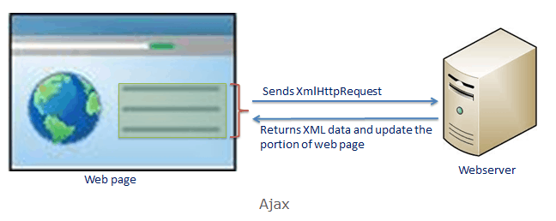
jQuery AJAX Introduction

Slide 3
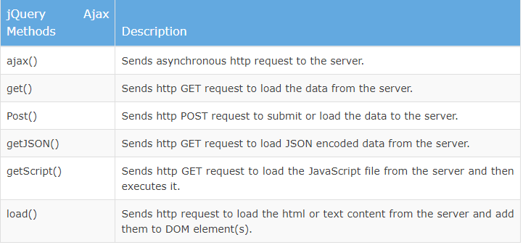
Ajax methods of jQuery

Slide 4
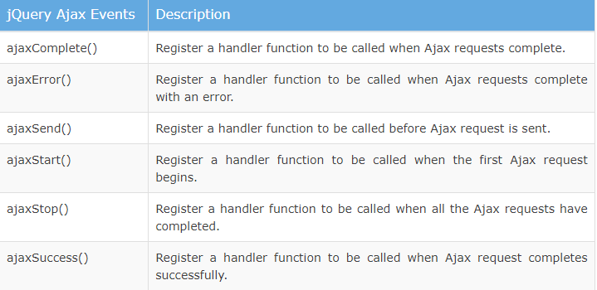
jQuery Ajax Events

Slide 5
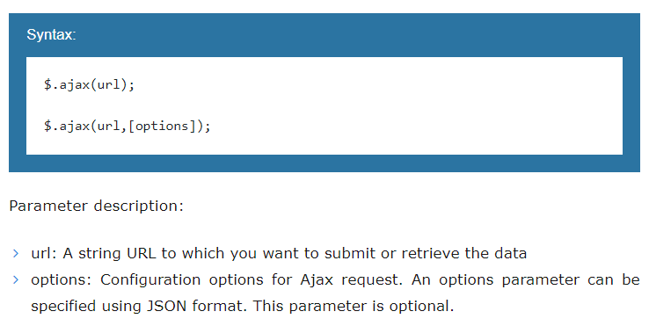
jQuery ajax() Method

Slide 6
jQueryAJAXDemo on JSFiddle
http://jsfiddle.net/ddtxra/60wme3pf/
https://jsfiddle.net/GRMule/WQXXT/

Slide 7
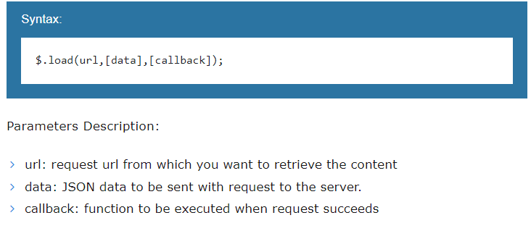
jQuery Ajax Load

Slide 8
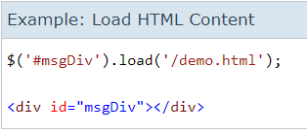
jQuery Ajax Load Example

Slide 9
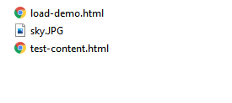
jQuery Ajax Load Demo

Slide 10
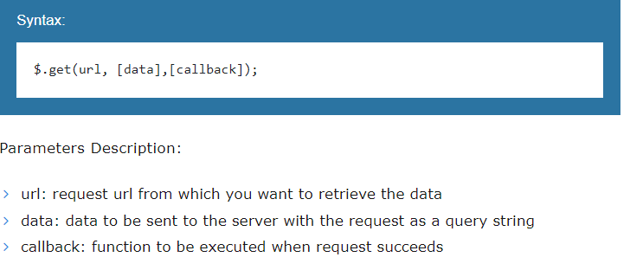
jQuery get() Method

Slide 11
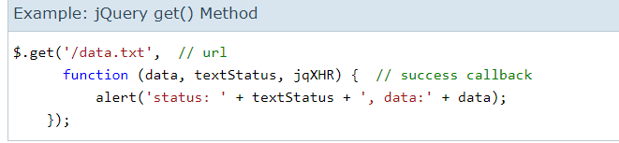
jQuery get() Example

Slide 12
jQuery Ajax GET Demo
http://jsfiddle.net/jensbits/2F4kN/
https://jsfiddle.net/CSCIE12/xzfvp9o5/

Slide 13
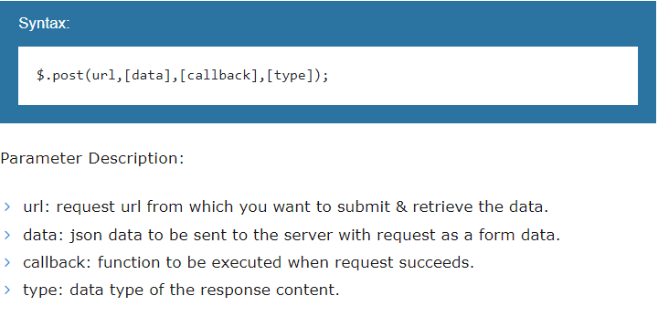
jQuery post() Method

Slide 14
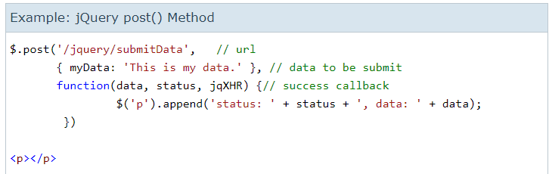
jQuery Post() Example

Slide 15
jQuery Ajax POSTDemo
https://jsfiddle.net/mikeym/Vr8FY/

